Slide 1
Art ^2

Slide 2
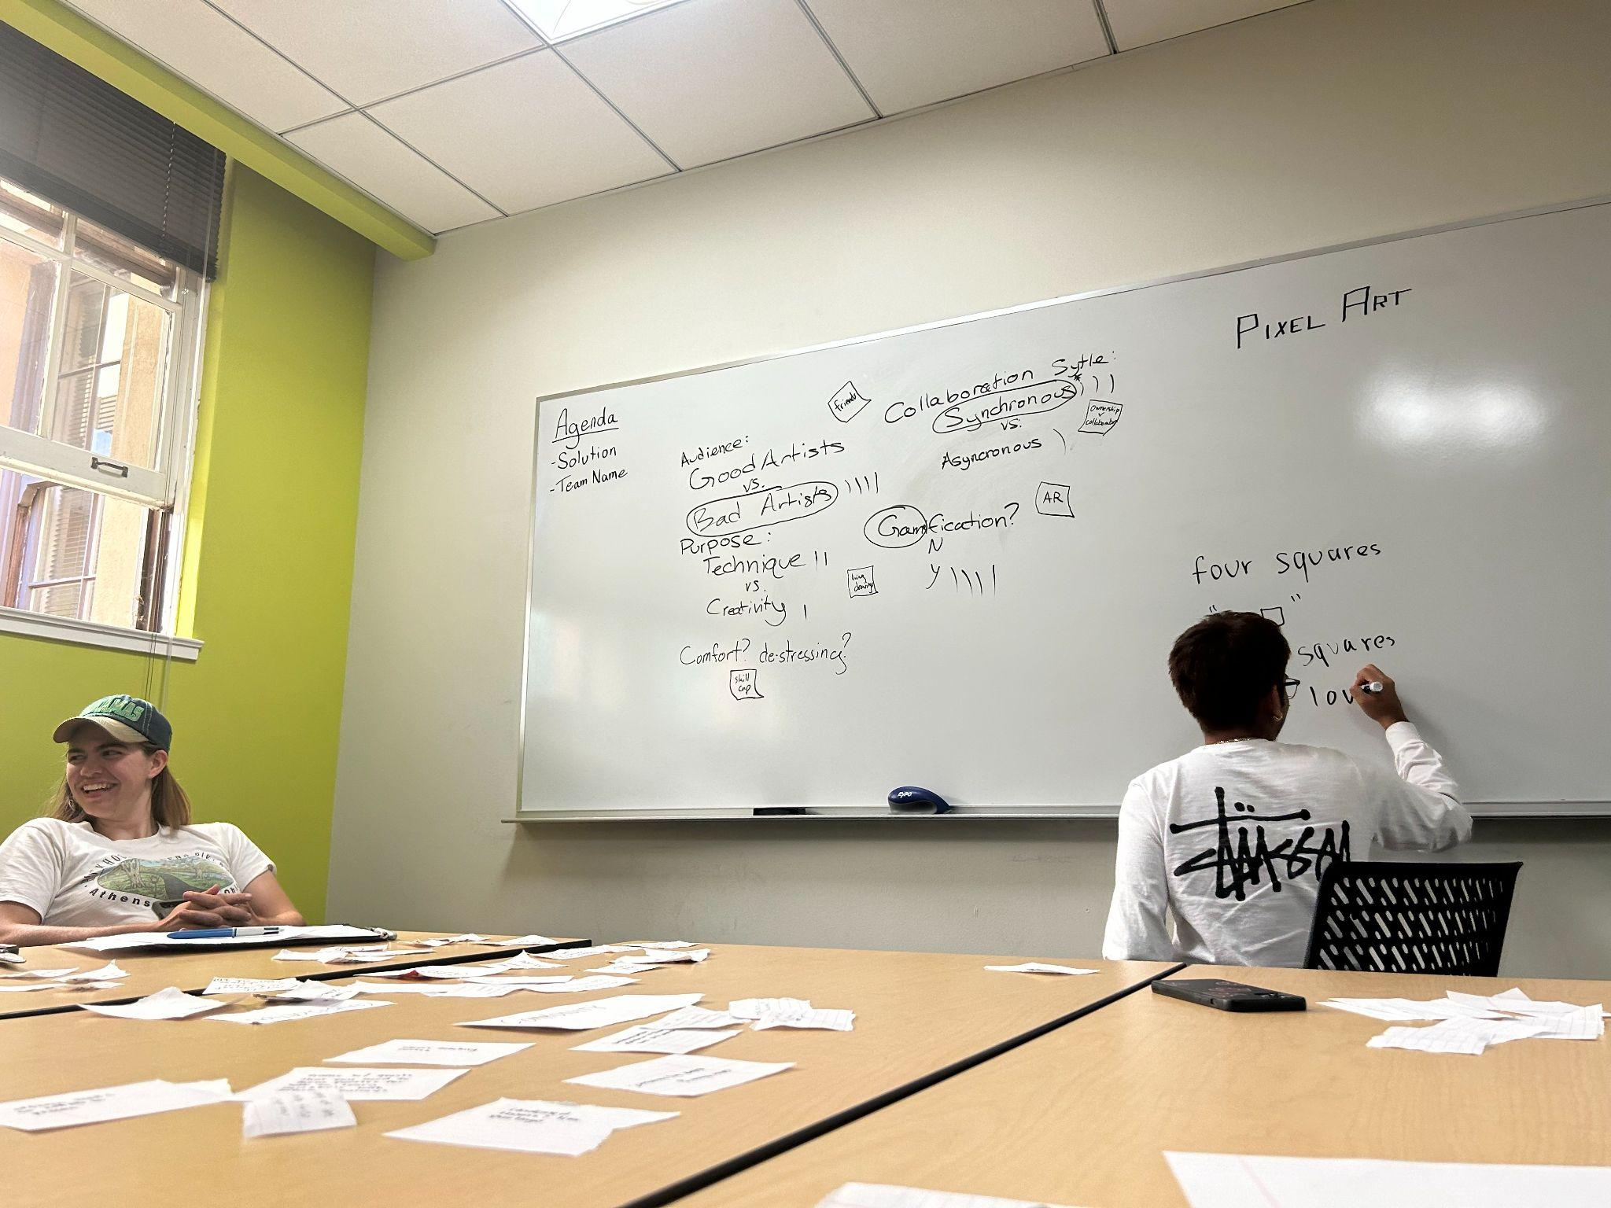
Team name generation (brainstorming and voting)

Slide 3
“Learn ART and Build your Community – One pixel at a time”

Slide 4

Problem Solution /Overview
Who is it for?
Early career adults who are interested in incorporating a little art to their lives but don’t have copious amounts of time.
Problem to tackle
Learning art is time consuming and often times isolates individuals.
Solution Synopsis
App that allows users to learn pixel art and collaborate with others to build a community.

Slide 5
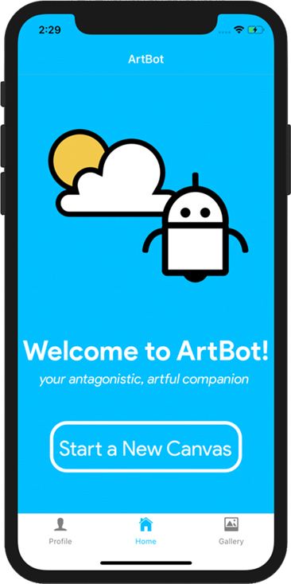
Comparison 1: ARTBOT (artbot project link)
Them
Type of feature - to improve artists creative adaptability by overcoming “the block”
Audience - limits to mainly artists who care about getting over “the block”
Ease of use - has users draw on mobile devices (either limits the users to tablet users or creates a subpar experience for phone users)
Us
Type of feature - to allow users to learn pixel art and build communities in the process
Audience - all young adults interested in art and building community
Ease of use - teaches people pixel art which is a lot more feasible with phones as you can just tap to fill in squares
Notes:
Marie Chu

Slide 6

Comparison 2: artally
Them
Type of feature: to allow art learners to develop skills through social/peer feedback
Audience: artists who want social interactive guidance.
Ease of use: have to draw outside of app and upload posts to then receive social fac
Us
Type of feature: allow users to develop basic skills through pixel art and collaboration
Audience: all young adults intersted in art and collaboration.
Ease of use: can just create and collaborate on phone

Slide 7


Comparison 3: Piskel
Them
Type of feature - Pixel art application with a very robust set of tools and features meant for individual work
Audience - People who are already familiar with making pixel art
Ease of use - can be hard to navigate as a novice, lots of trial and error in figuring out what tools to use when
Us
Type of feature - Simpler pixel art application with more emphasis on fundamentals and collaborative tools
Audience - People who have never made pixel art before, or are trying to make it collaboratively
Ease of use - users will get walked through and unlock different tools as they learn.

Slide 8

Comparison 4: DrawaBox
Them
Type of feature - provides lessons to help beginner to intermediate artists develop drawing technique
Audience - intermediate artists motivated to improve their skills
Ease of Use - users read lessons or watch videos online but create art with traditional tools
Us
Type of feature - includes lessons to help beginner artists develop pixel art technique and creative design
Audience - people who appreciate creative pursuits but don’t self motivate to do art
Ease of Use - interface is on the phone and can be used anywhere

Slide 9
Values in Design
Solution from last week:
“Have people draw together to form a single piece of art”

Slide 10
Stakeholders
Direct stakeholder:
People drawing on the paper
Indirect stakeholders:
Friends and peers of people who did this activity
People in public spaces where they performed the activity in

Slide 11

Ethical implications #1
The siren
Collaborating on a single drawing allows you to engage with others
Respects boundaries as it’s a quick activity that you can only do with others
May be distracting if activity is performed at work
Notes:
Choose two Tarot cards of
tech to identify and analyze two ethical implications of your solution. Does this ethical
implication reflect an underlying value tension? Does it point to any stakeholders you may
have previously overlooked? How might you go about addressing these ethical implications
in your designs?

Slide 12

Ethical implications #1 - Reflection
Value tension for promoting collaboration:
Individuality
Independence
Indirect stakeholders
Employers
Address by:
Enforcing a time cap for the activity
Notes:
Choose two Tarot cards of
tech to identify and analyze two ethical implications of your solution. Does this ethical
implication reflect an underlying value tension? Does it point to any stakeholders you may
have previously overlooked? How might you go about addressing these ethical implications
in your designs?

Slide 13
Ethical implications #2
The forgotten
Amputees
Individuals with Ataxia (loss of muscle control)
Individuals with vision impairment
People who despise collaboration

Slide 14
Ethical implications #2: Reflection
Value tension if we want inclusion:
Complexity of solution to handle all cases
Indirect stakeholders:
Amputees
Individuals with Ataxia (loss of muscle control)
Individuals with vision impairment
… others who cannot collaborate easily on a drawing with other people
Address by:
Haptic feedback/tactile drawing material
Voice activated drawing
Giving the option to collaborate or work individually
Notes:
Does this ethical
implication reflect an underlying value tension? Does it point to any stakeholders you may
have previously overlooked? How might you go about addressing these ethical implications
in your designs?

Slide 15
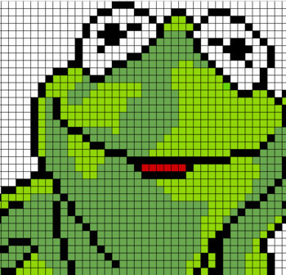
Tasks (3-5)
[Simple] Creating a drawing
The most common task a user wants to perform.
[Simple] Following a lesson
An introductory task a user would perform.

Slide 16

Tasks (3-5)
[Moderate] Sharing creations with others
User does not perform this task as frequently as creating a pixel art.
[Complex] Collaborating with others
This task is even more uncommon and complex as it requires back and forth between multiple active users on the app.

Slide 17
Video StoryBoard

Slide 18
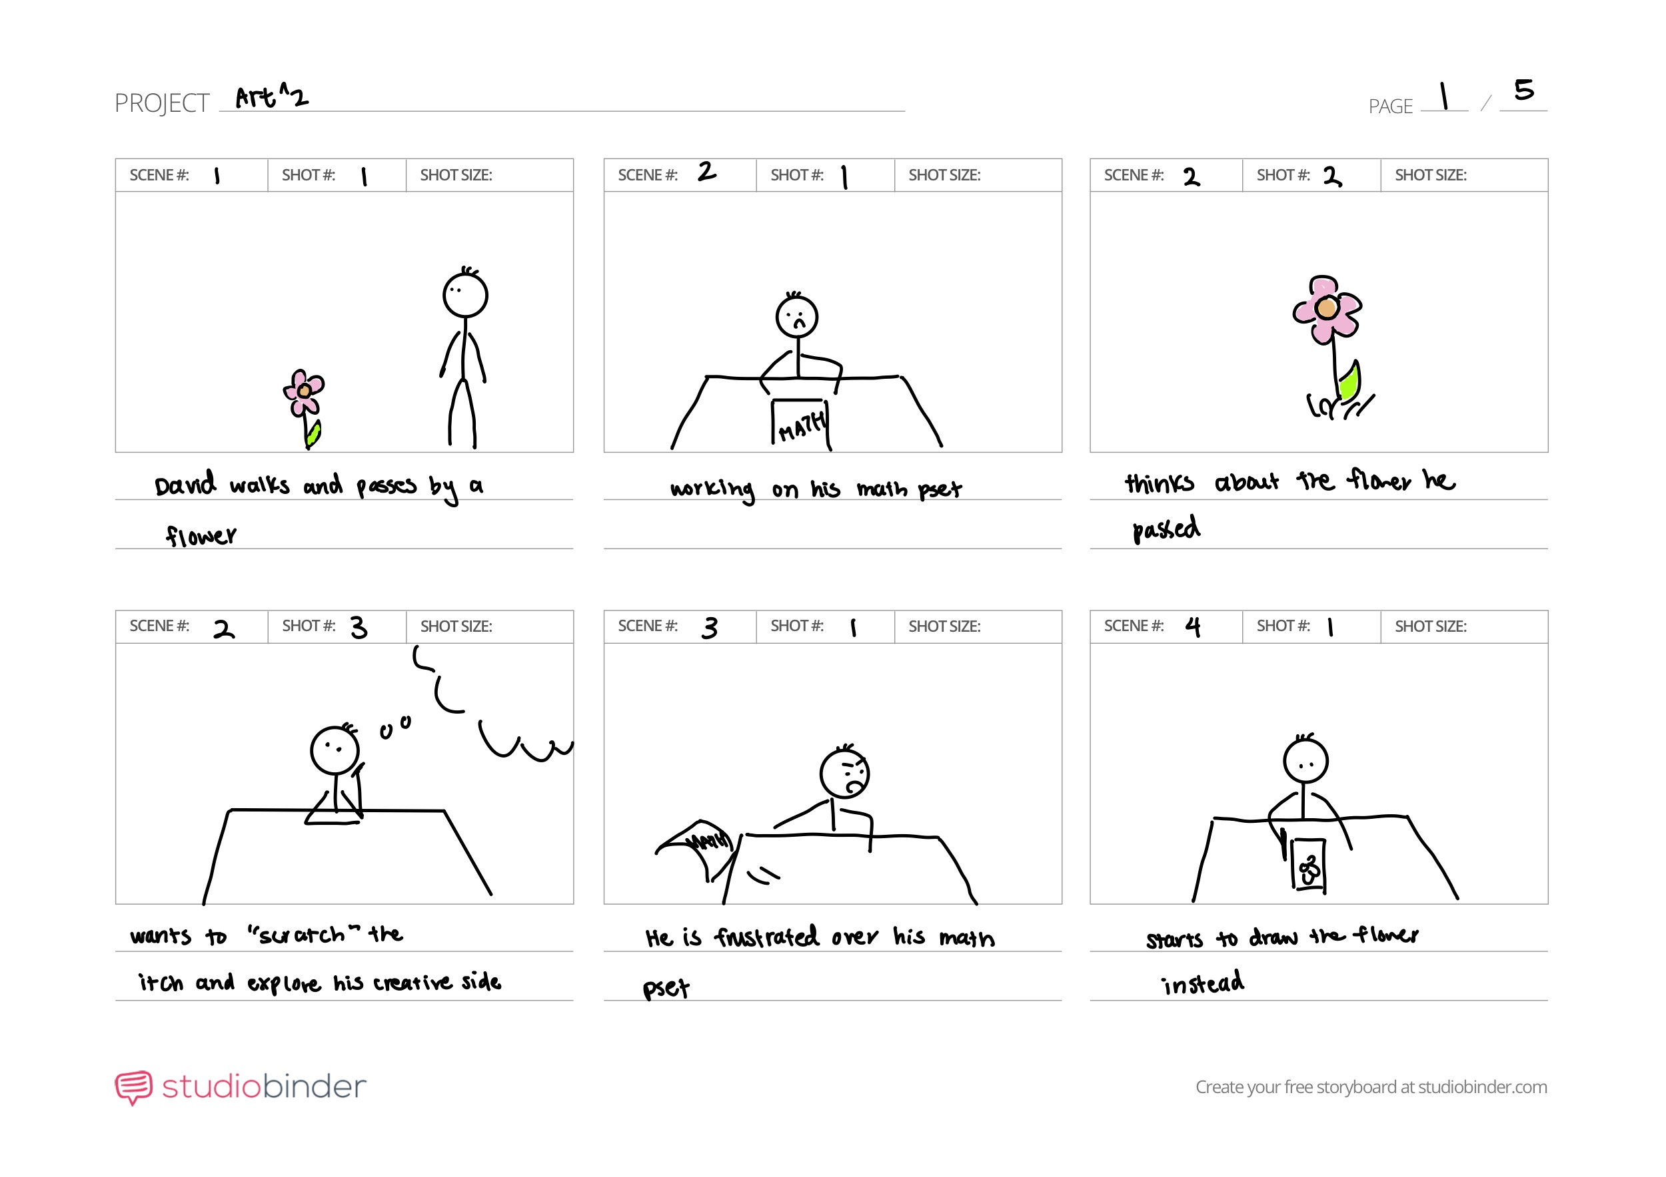

Slide 19
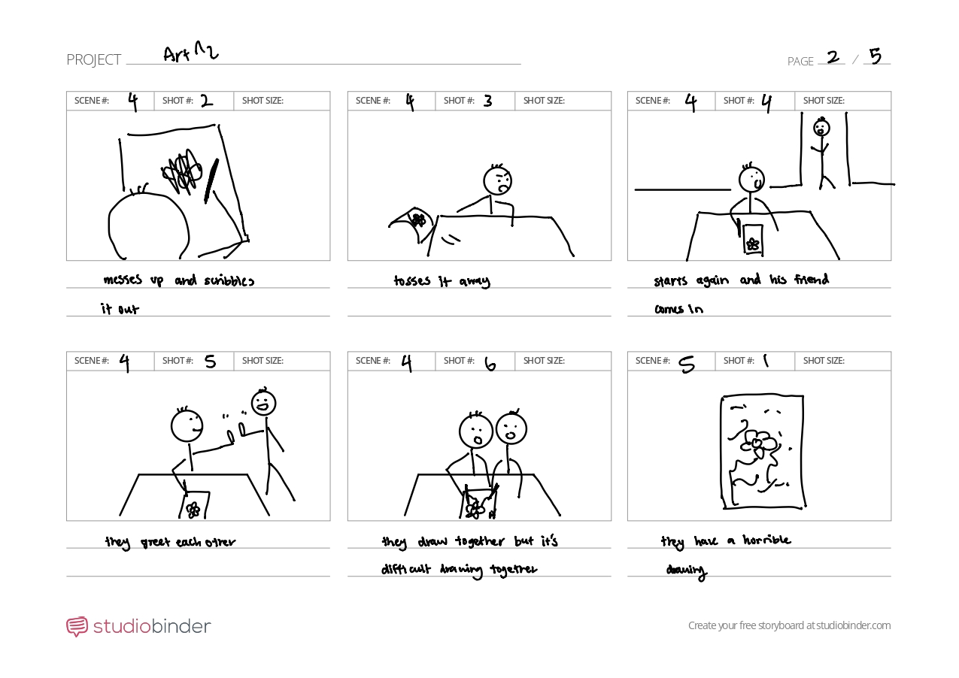

Slide 20
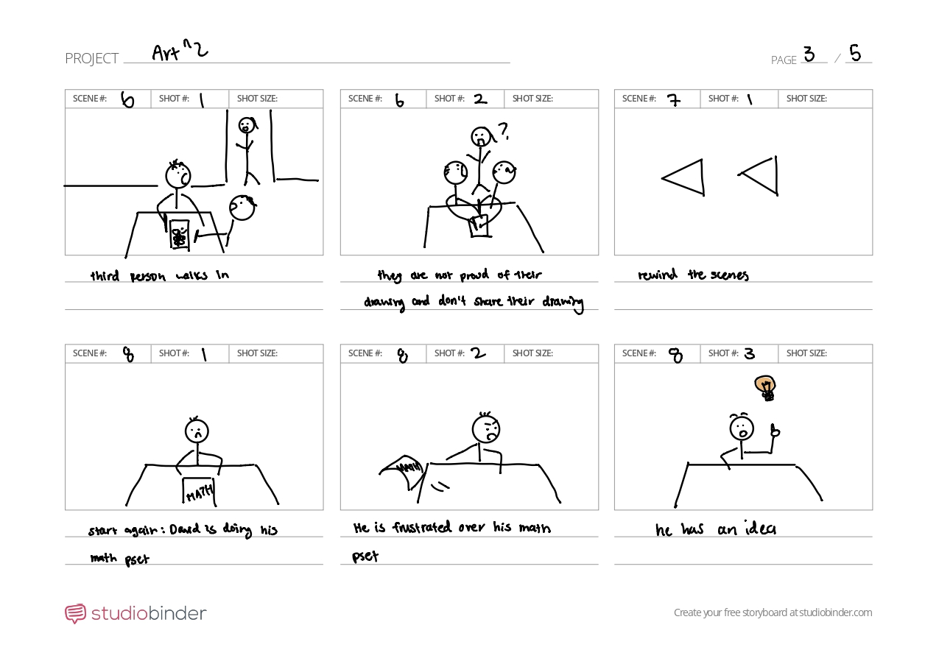

Slide 21
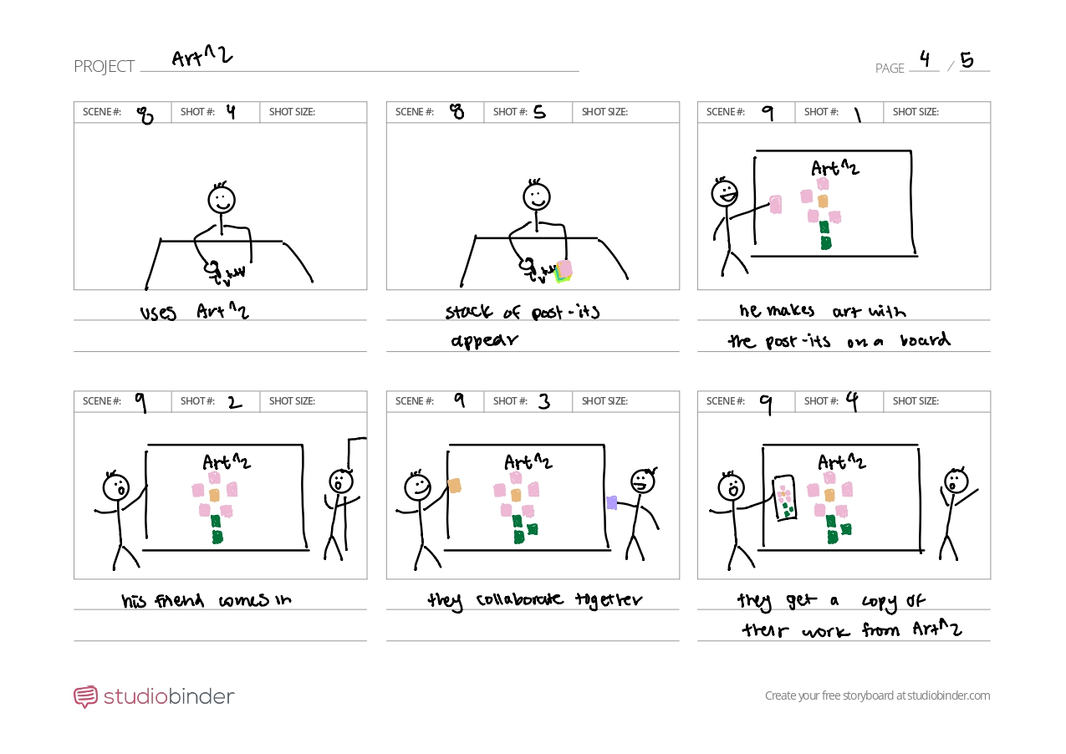

Slide 22
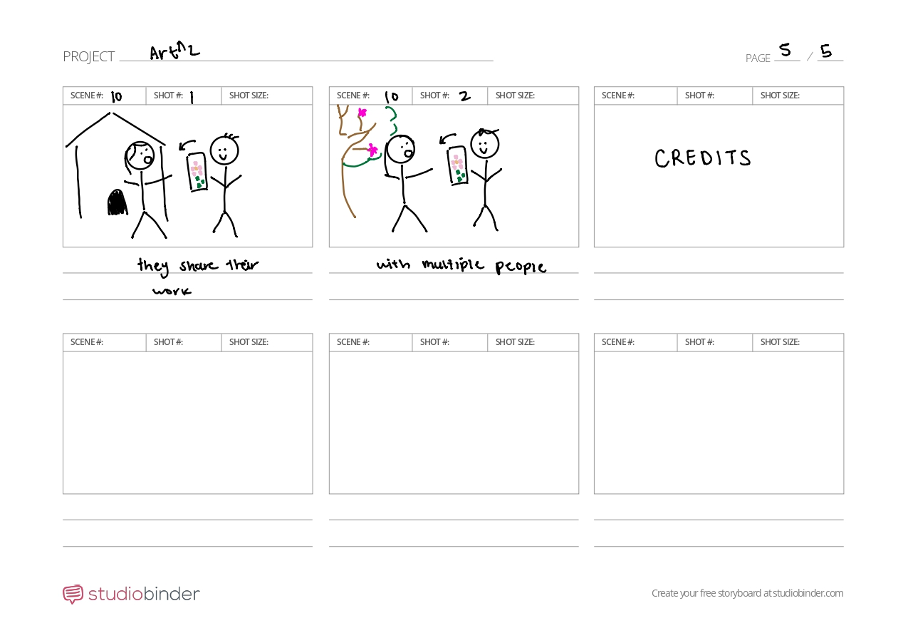

Slide 23
:)
Link to video: https://youtu.be/kgT3nzMHrsY

